Slide 1
SAFE DRIVE ANALYSER
PY
Guide: Dr. S. Surthir
Team Members:
Craig Roberts - 20BAI10022
Diksha - 20BAI10212
Chinmay Joshi - 20BAI10133
Taha Habib - 20BAI10108

Slide 2
INTRODUCTION
Inspect driving behaviours that could lead to accidents or inefficient driving.
Monitoring, analysing, and optimising driver performance and fleet operations in order to ensure safety and improve efficiencies.
Analyzes face anatomy and Euclidean distance.
It determines whether the driver is already sleeping, active, or drowsy based on the Pre-defined ratio's conditions.
Allows the driver to track his driving patterns and provides safety recommendations.
Alarms you as needed based on the situation, and switches to sleep mode if no activity is detected.

Slide 3
EXISTING WORK WITH LIMITATIONS
INTELLICAR TITAN
IDLE ALERTS AND ALARMS
Its ecosystem provides overall optimization and analysis of driving performance. However, no safe drive analysis is incorporated.
Estimates the idleness of a person based on limited movement. However, it cannot distinguish sleep and drowsy states.

Slide 4
PROPOSED WORK AND METHODOLOGY
01
04
Proposed Work
Primary Libraries
02
05
Working
Analytical Conditions and Evaluation
03
06
Language
Output
A recognition system that determines a person's drowsiness.
We are using some of the lesser-known libraries that are available. Like dlibs, CV2, imutils.
It alerts the driver by displaying a caution sign on the screen and also by a sound.
Face Utilities used to calculate Euclidean distance associated with the eyes in order to evaluate a pre-defined ratio.
Python is used to code the analyser.
The ratio determines the drowsiness status of a person based on which a buzzer goes if asleep or drowsy.

Slide 5
NOVELTY OF THE PROJECT
We used the concept of face recognition and idle alert alarms (A software which recognises if a person is drowsy or not) to make this safe drive analyser.
Moreover, Euclidean Distance is used to gauge the drowsiness status of a person.

Slide 6
REAL-TIME USAGE
One of the major applications of this software is scanning the face of the driver/user and accordingly notifying them to stay alert while driving

Slide 7




HARDWARE & SOFTWARE REQUIREMENTS
HARDWARE REQUIREMENTS
SOFTWARE REQUIREMENTS
To program and execute the code, Python is required.​
It is OS independent
Webcam
Microphone
Chip

Slide 8
OVERALL SYSTEM ARCHITECTURE DIAGRAM
Initialize
Blink Detection
Camera (Video Capture)
Evaluation Euclidian Distance
Face Detection
After Initializing Landmarks
Compute Ratio
Blink Condition
Status Analysis
Detection based on calculation
FPS Increment
Face Detection
Array
Sleep
Status
array
Overall Dynamics and Anatomy
Drowsy
Landmarks and Eye Landmarks
Awake
Alarm

Slide 9
Module split-up
Libraries used : dlibs, CV2, imutils and numpy
Initializing landmarks and face detection
Using live video, detect facial traits
and focus on establishing landmarks.
Determining the distance and ratio
Calculate the Euclidean distance between the landmarks, compare and evaluate against a predefined ratio of 0.25.
Face detection
By focusing on specific facial landmarks, it is possible to tell the condition of the array by detecting general face structure and ocular landmarks.
Status analysis
A status array is passed that analyzes a person's status based on the rest detected and evaluates the ratio to determine if the person is active, sleepy, or drowsy

Slide 10
Module split-up
Alarms
It issues notifications or alerts based on the person's condition. When a person is sleepy or drowsy, the device will automatically start alarming until the status becomes active again.

Slide 11
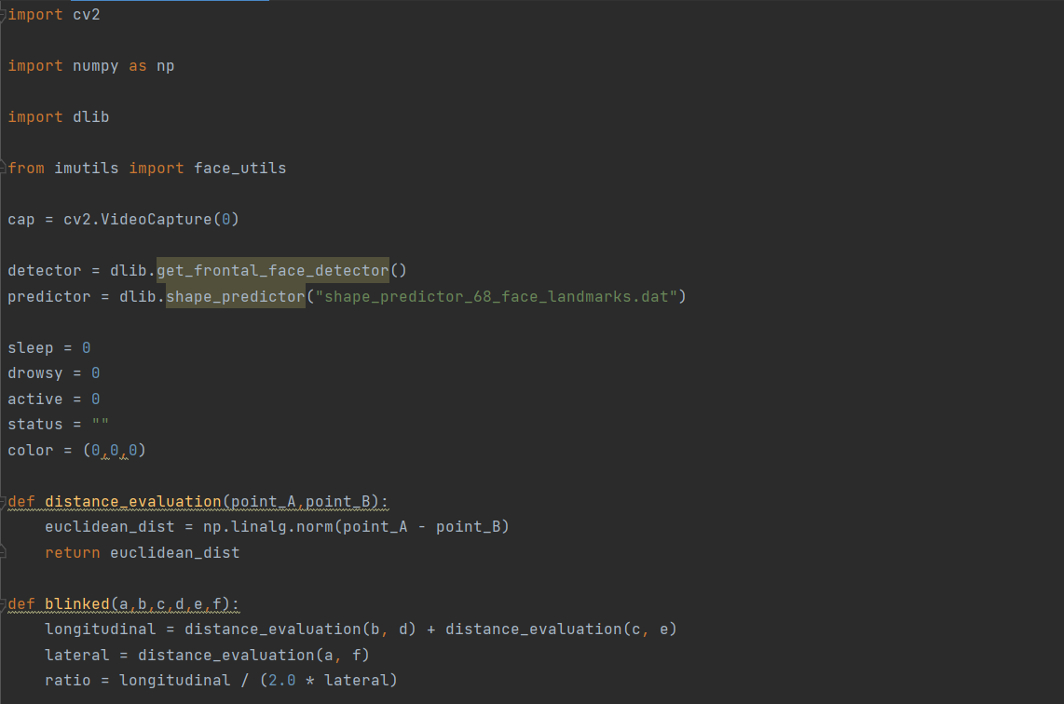
IMPLEMENTATION AND DEMO
Video Capturing is initialized, and face detection is enforced using dlib's '68 face landmarks' function.
Euclidean distance is evaluated for the landmarks lying on both eyes separately.

Slide 12
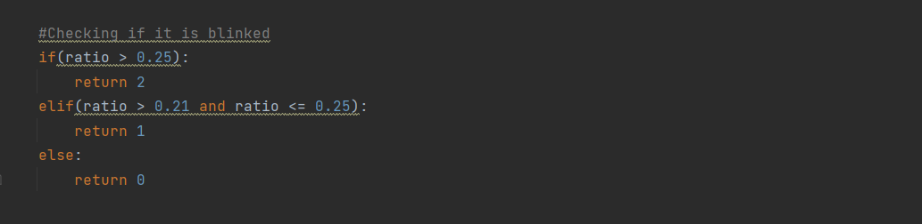
IMPLEMENTATION AND DEMO
The ratio educed using Euclidean distance is compared with a predefined value of 0.25 to determine the status.

Slide 13
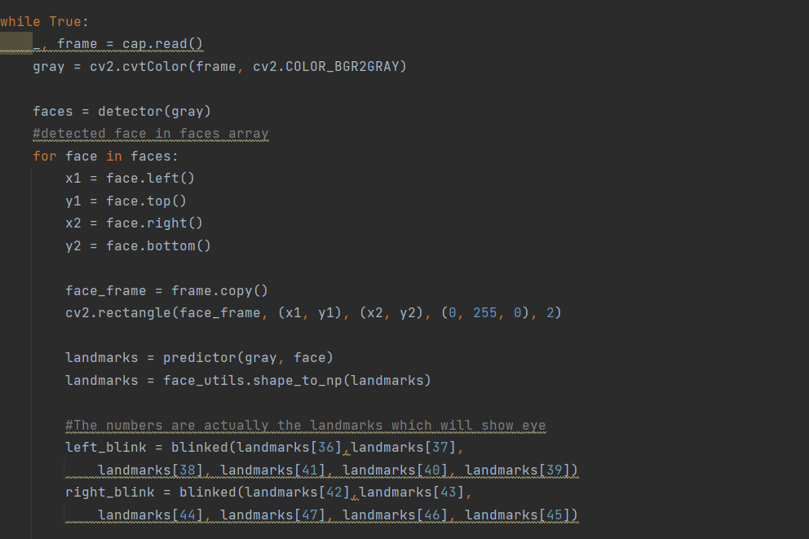
IMPLEMENTATION AND DEMO
A video frame is introduced to detect and display the camera's output.
Face dimensions are appended in an array on which the framing and detection will be performed.
Euclidean distance is calculated using landmark indices for left and right eye separately.

Slide 14
THANKS!

